Slide 1
Mapping the Value Stream – Lean Kanban

Slide 2

Value Stream:
All of the activities required to transform a requirement into a delivered product (including activities that do not necessarily add value.)
1

Slide 3
Kanban Column Selection
Lean measures and minimizes the time spent between columns (minimize waste)
Kanban measure the time spent in the column (optimize flow)
Kanban is a pull system. Columns pull from the left.
Therefore there must be a “done” column for each process column, which the column to the right can pull from
Note that a column should be associated with a team, and the transitions should be from team to team.
Specs
Specs
Done
Dev
Dev
Done
Testing
Testing
Done
Review
Review
Done
Release

Slide 4
Kanban Column Selection
Identify predictable series of steps to transform a requirement to a delivered product.
Things that take less than a day should probably not get a column, but should be included in another column
Meet with Dev and Ops to review that chart, to see the world through the same lens
Initially you just want to capture the current process, (we don’t want to introduce improvements yet.)
Senior management of the project should be involved in the column selection
Long-Term Goals
What’s our average lead time; how can we improve it?
Identify where work gets stuck in the process
Identify remediation strategies – Remove constraints, hire people, re-appropriate resources
Notes:
https://leankit.com/blog/2017/08/value-stream-mapping-for-software-development/

Slide 5
Useful Metrics
Cycle Time (C/T) – Time from when Jira is moved to started, to when it is moved to done.
Process Time (P/T) – Time actually spent working on that process
Takt-Time (Takt) – Time allowed between the start of production of one unit and the start of production of the next unit in order to meet customer demand.
If a widget factory operates 480 minutes per day, & customers demand 240 widgets per day, then takt time is two minutes
Changeover time: C/O – Time required to prepare the development environment for a new product.

Slide 6

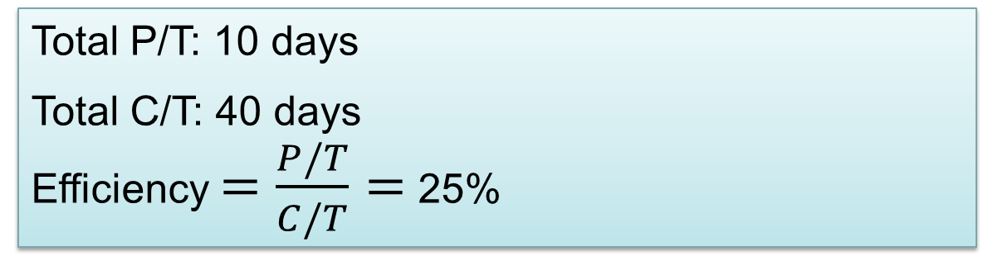
Value Stream Mapping Metrics
Specs
Dev
Testing
Code Review
Release
P/T: 2 days
P/T: 5 days
P/T:
1 day
P/T:
1 day
P/T:
1 day
9 days
5 days
5 days
21 days
Lean shortens these
Kanban shortens these (Limit WIP)
Total P/T: 10 days
Total C/T: 40 days
Efficiency $=\frac{P/T}{C/T}=$25%
Legend
P/T: Process time
C/T: Cycle time
Lean Principle: Reduce Delays

Slide 7
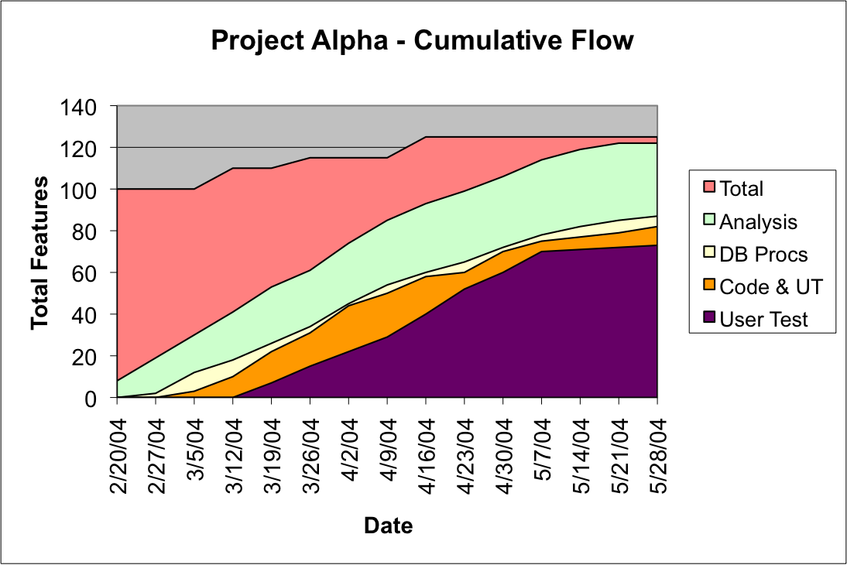
Cumulative Flow Diagram

Slide 8
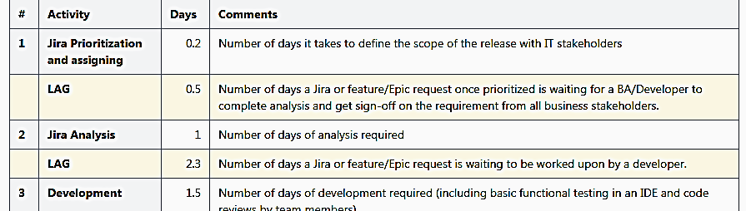
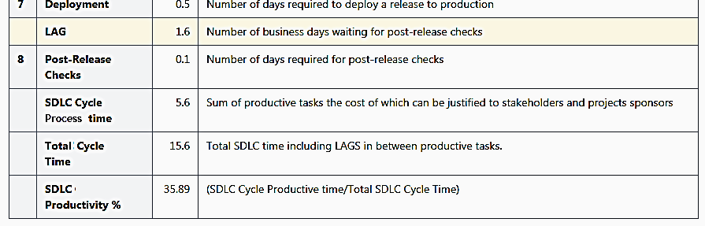
Calculating Productivity

Slide 9
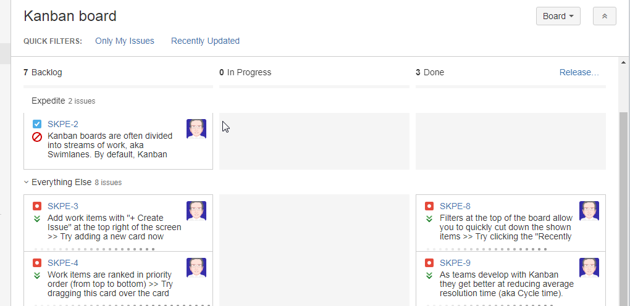
Jira Kanban

Slide 10
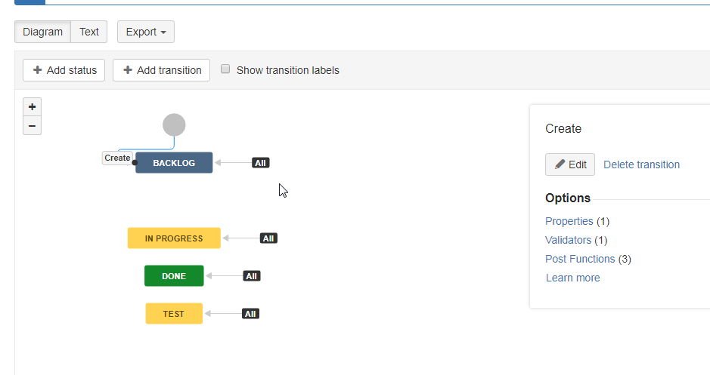

Slide 11
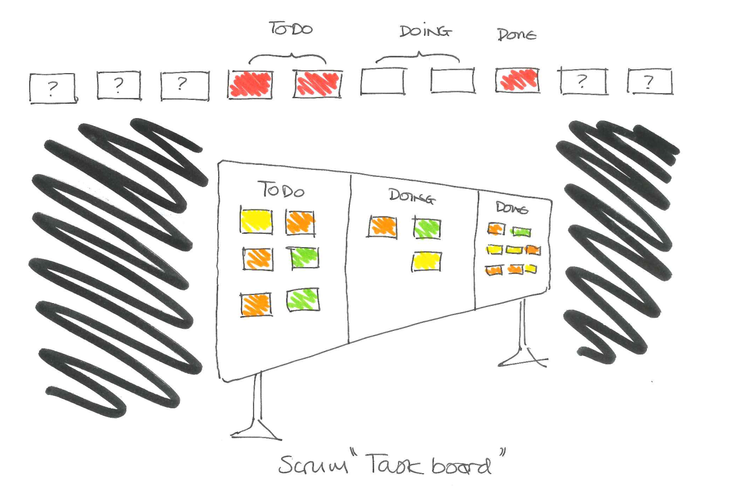
Notes:
I’ll describe how I found Value Stream Mapping a useful tool to uncover the reality of delivery systems.
The first way of DevOps is “System Thinking”
As a Scrum Master and Agile coach my job is helping my team. I found 90% of that work took place outside the team.
The Scrum Task board isn’t enough.
First of all, it’s columns conflated and therefore concealed a lot of information.

Slide 12
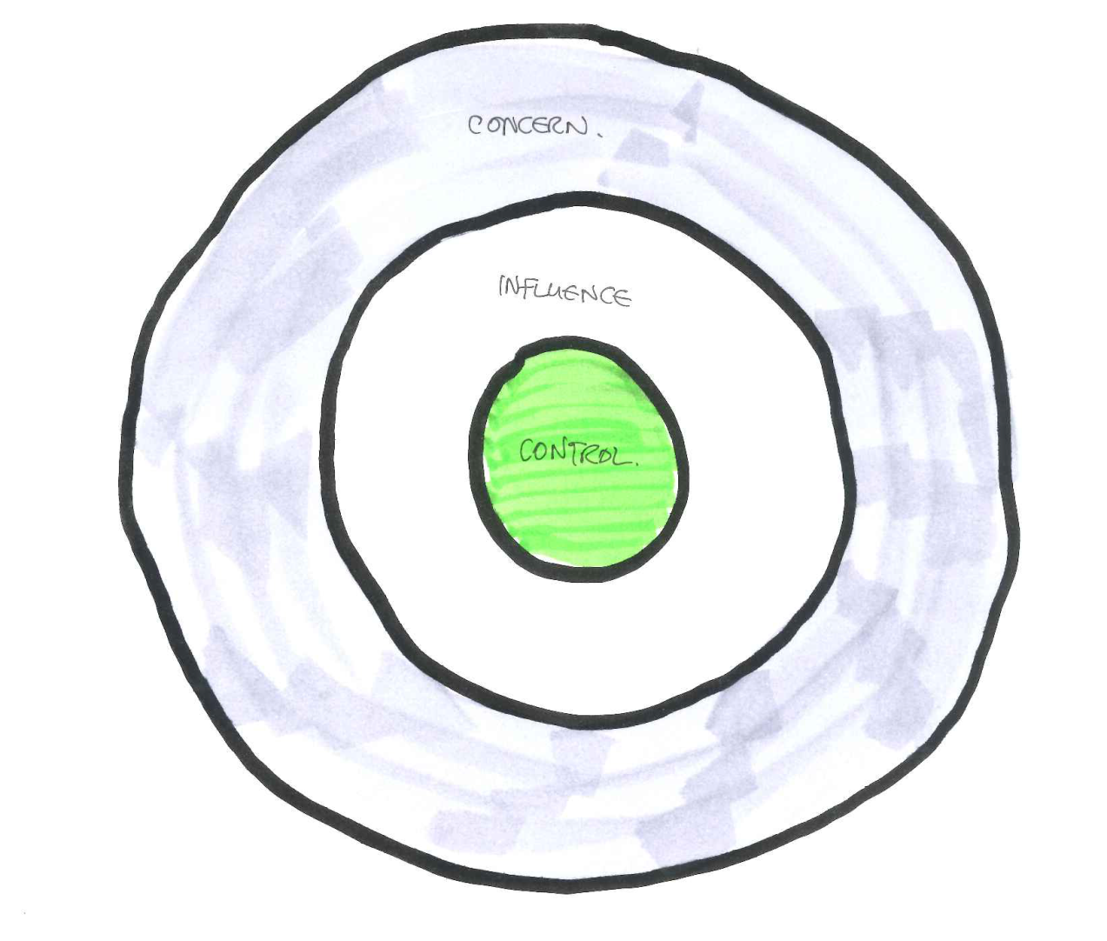
Notes:
Second it’s scope was too narrow
Where 90% of that work took place outside the team – it was hidden
I wanted to shine a light on repeat offenders in the process and promote change.
The Scrum Board only addresses the Zone of Control – and gives a false sense of security.
Ignoring other teams (where we had marginal influence) and forces of nature like earthquakes, CEOs or Infosec

Slide 13
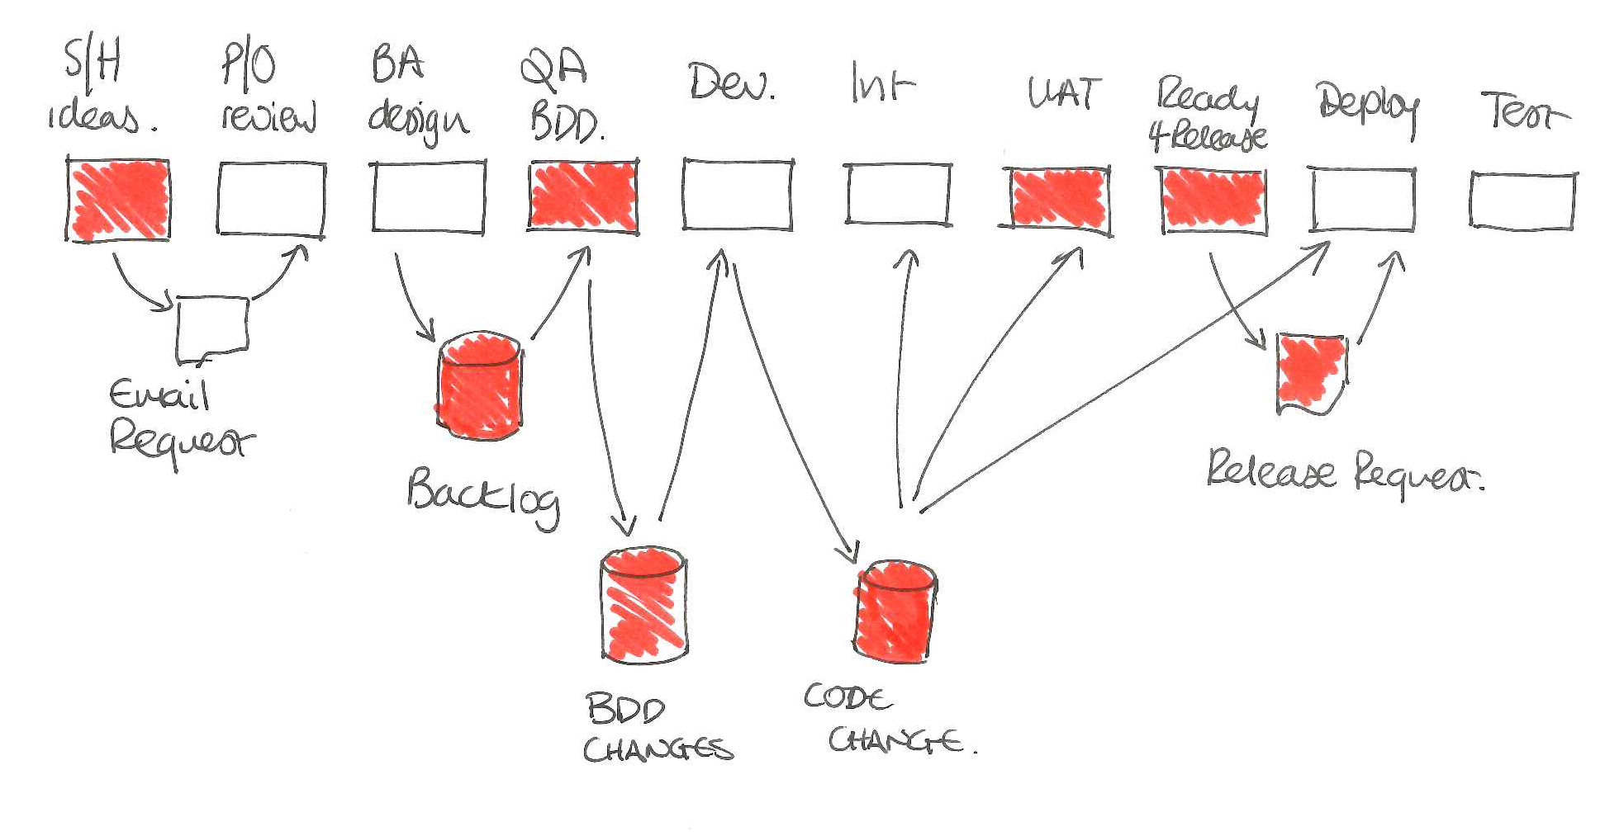
Notes:
As a consultant, value stream maps are a quick way to get a picture of the shop floor at a new (to me) business.
It helped me to emphasize to leaders, where the biggest constraint was – this provoked discussion, insight and action!
Those red areas are points of constraint we identified and addressed in a delivery system for a UK high-street bank’s mobile app.

Slide 14
Tricks to Value Stream Mapping
Keep a diagram on a flip-chart or a white-board
Engage people along the value stream to contribute
Keep it visible
Get people from different groups to contribute – does their process look like that?
Get people from the left and right of the stream to contribute – does it match their expectations?
Are there several value streams?
If it looks ugly that’s okay (the system may be ugly)
Notes:
The Value Stream map is a great tool for a weather report “are marketing pushing a promotion?” , “is the integration server dead?”
There will be zones of concern or zones of influence we don’t struggle with frequently enough to place on our Kanban, but we want to remain mindful of them.
Having the Value stream map available all the time prompts conversations: corrections, more detail, lack of information, leads and contacts, recommendations.
We want to grow our zone of control and zone of influence by networking and increasing communications.
At a broadcasting company, we identified two different value streams and changed the profile of a significant amount of our work to use the optimised value stream.
As a Scrum master, identifying problems is mostly letting complexity be visualised, it’s displeasing and provokes change.

Slide 15
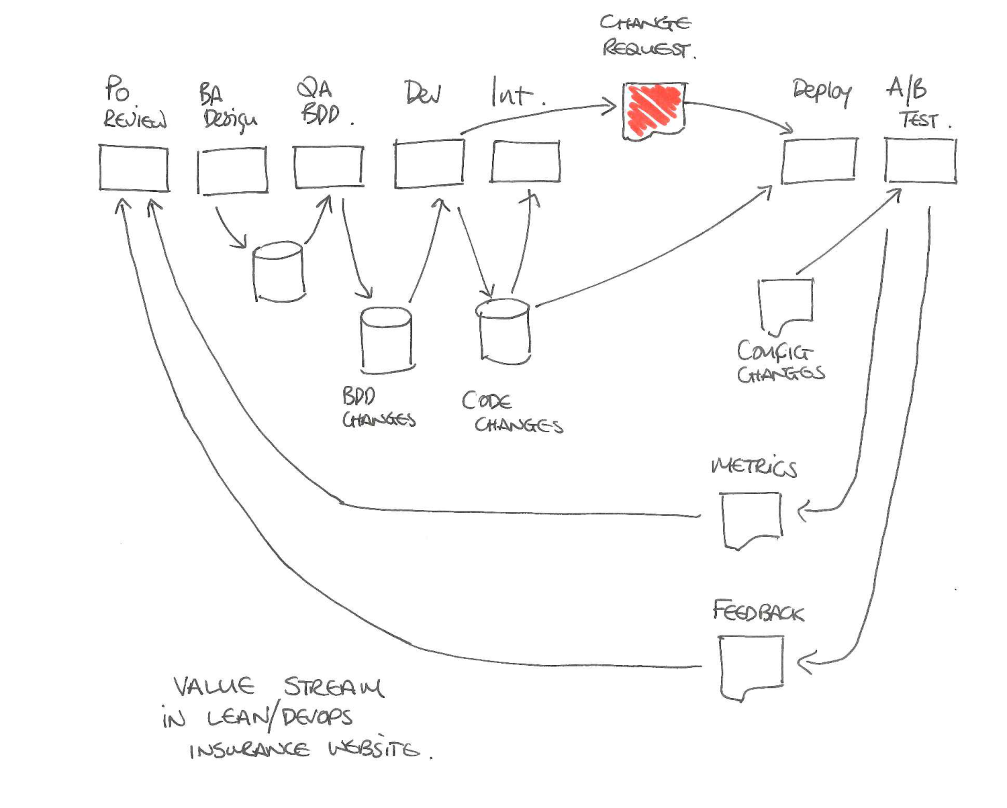
Notes:
Value streams get out of date, if we’re improving things we are changing the structure of the value stream
At the UK’s largest online insurer, delivery had been improved (left to right) so much so we felt safe to look at the second way
Improving feedback from right to left. This meant A/B testing with feature toggles, increasing telemetry and analysing.
This Value Stream Map was radically different to the one recorded 12 months before.

Slide 16
And now, it’s Retrospective time!
Backlog | Plan (3) | Develop (3) | Etc. (4) | Done
Questions?

